Slide 1
WCSUP-2018-0017
Applicant: Randy Soule, Landowner
Agent: Matthew Setty, Principal Scientist
Nevada Environmental Consulting, LLC
216 California Ave #763
Reno, NV 89509
matt@nvenv.net
www.nvenv.net

Slide 2
Project History
Landowner initiated maintenance (removal of trash, vegetation and flood debris) pursuant to Washoe County Development Code section 418 (June 2018)
County deemed extent of activates exceeded the allowable actions under Ordinance
Landowner was aware of SWPPP requirements for disturbance over one acre, and maintained new disturbance under one acre. Was not aware of need for Stormwater permit when working near a jurisdictional waterway
Work was halted pursuant to discussion with Washoe County and application for SUP was submitted by the Landowner
Landowner was notified by NDEP (8/28) and USACE (9/5) of non-conformance with regulations and was responsive to agency requests for information
Landowner retained representation to engage agencies on September 10, 2018
Compliance efforts with Federal and State agencies have been initiated as of September 10, 2018
Stormwater regulation compliance was obtained on September 18, 2018

Slide 3
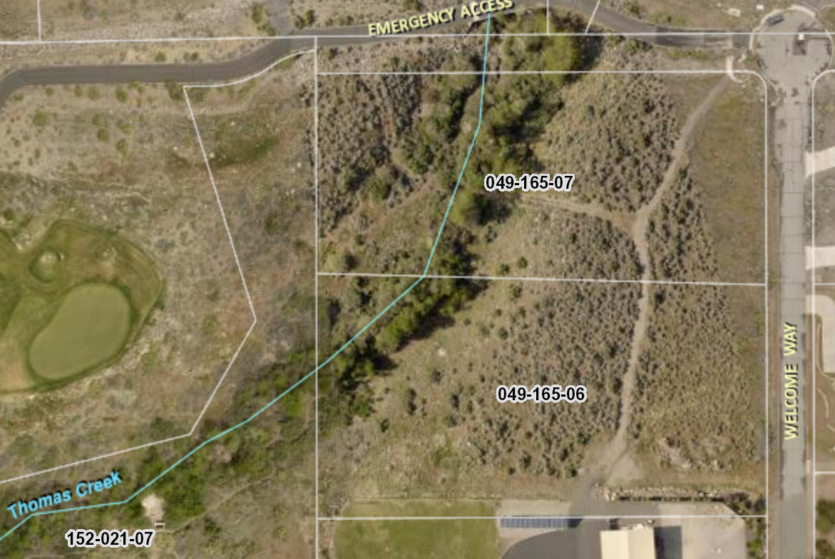
Soule Property
Washoe County
Soule
Soule
Washoe County
Soule

Slide 4
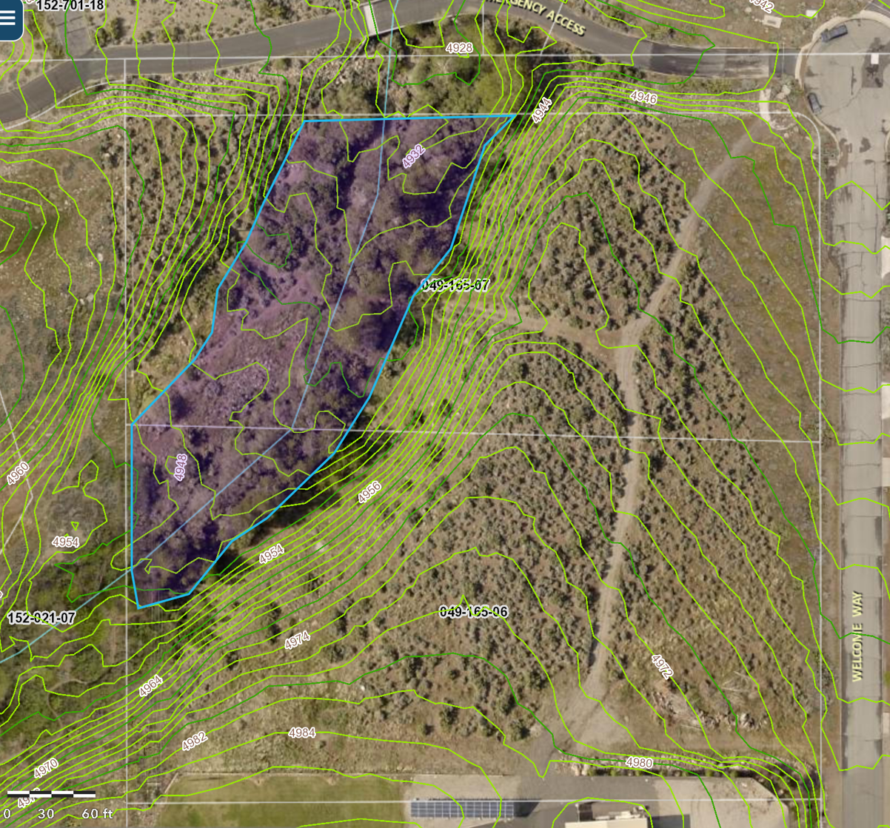
Topographic Setting
Grading consisted of vegetation removal over most of the disturbed area
Landform changes related to access and fence construction shown in red
Topography outside red circles remains unchanged, as is evidenced from exsisting vegetation

Slide 5
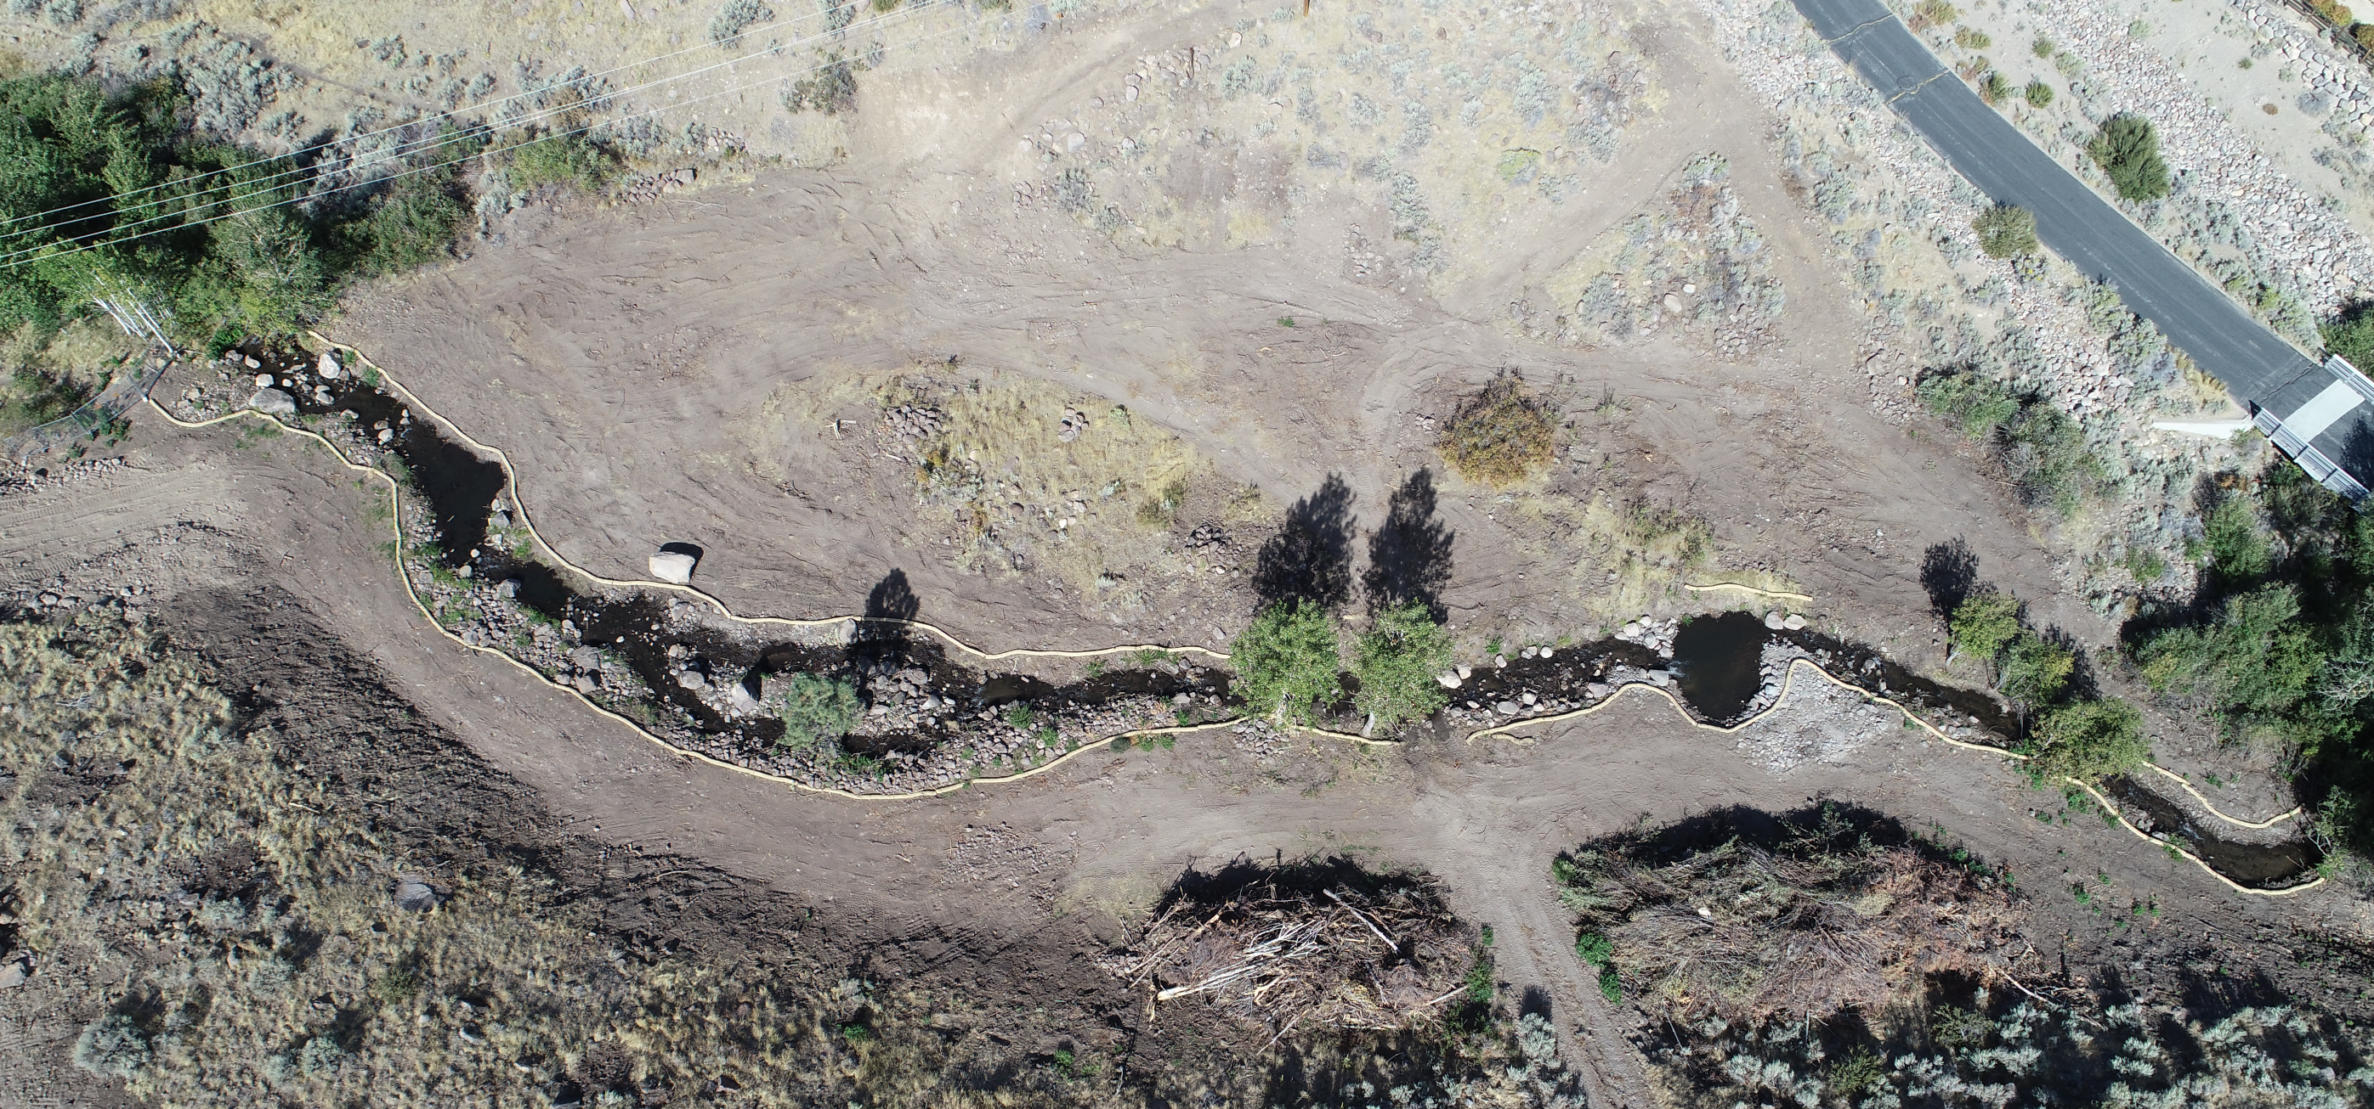
Project Related Land Disturbance

Slide 6
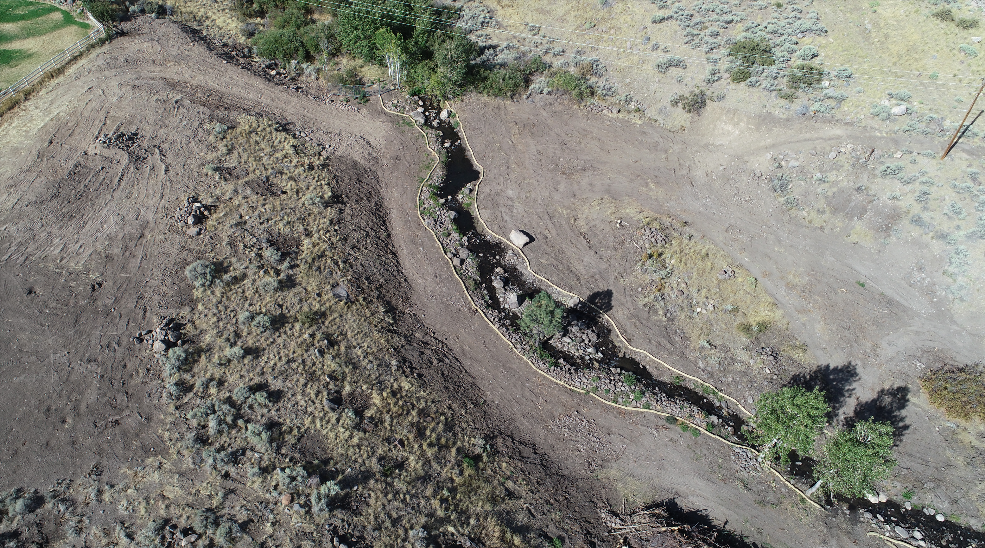
Project Related Land Disturbance

Slide 7
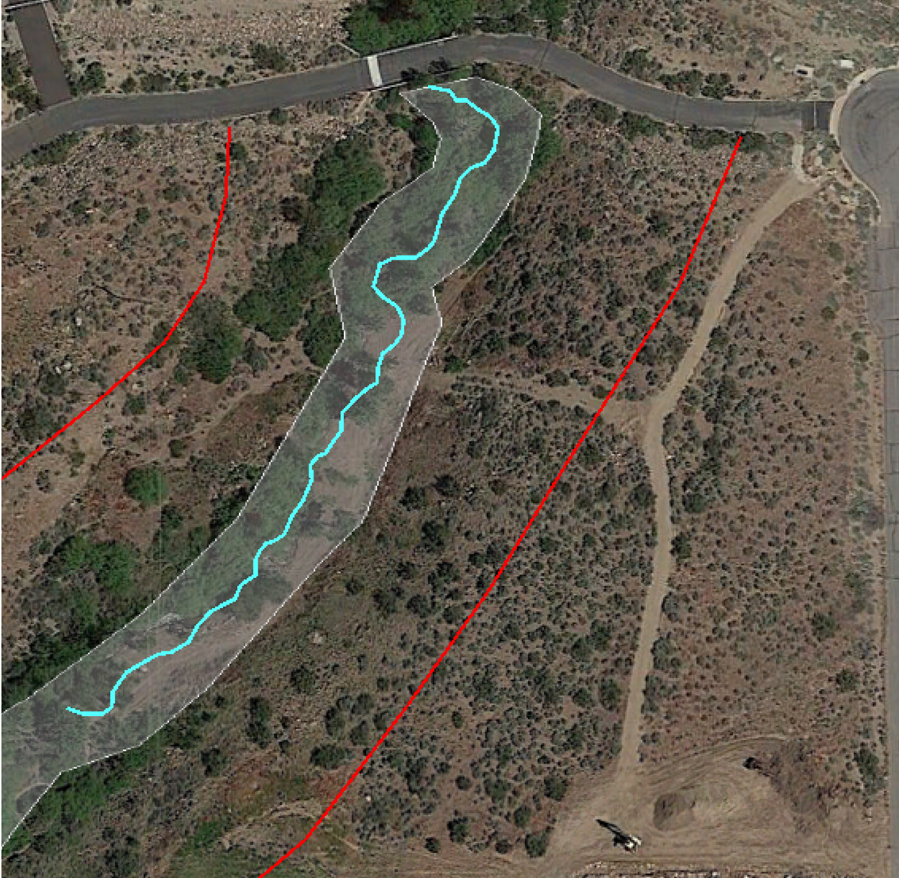
Project Impacts
Sensitive Steam Zone (300’)
Critical Stream Zone (60’)
and
Pre-project land disturbance
Sensitive Stream Zone
Critical Stream Zone
Sensitive Stream Zone
Areas of Existing Land Disturbance

Slide 8
Regulatory Compliance Activity
USACE Request for information – Issues related to impacts below the Ordinary High Water Mark (OHWM) are regulated under Section 404 of the Clean Water Act
Cultural Resource Survey (Class III Pedestrian Survey) in compliance with the NHPA is complete and a negative findings report has been submitted to the USACE.
NDEP-BWPC authority is subject to permitting pathway set forth by the USACE under the Clean Water Act (Stormwater Permit CSW-45222)
NDEP- BWQP Administers the Clean Water Act Section 401 Water Quality Certification
Submittal of Restoration Plan to USACE will determine the need for a NDEP-BWQP CWA 401 water quality certification
Nevada Division of State Lands (NDSL) – Working-in-Waterways Permit - Required when disturbance of jurisdictional lands or streambed of a water of the State. This permit may be waived as not further channel corridor disturbance is propose.
Proposed Restoration Plan meets State, Federal and County restoration requirements

Slide 9
Compliance Assurance
SWPPP – Six Month vegetation establishment and erosion and sediment control period. Stabilization inspection required prior to Notice of Termination (NOT) of SWPPP
Failure to implement and maintain stormwater controls may result in monetary fines under the CWA
WCSUP may require financial assurance for vegetation establishment. Unclear what the success criteria will require prior to release of financial assurance funds/bond.
Contractual obligations of industry professionals (Engineer and Environmental) hired to design and implement restoration plan (Prof. liability, E&O ins.)
Landowner agrees to provide additional financial assurance deemed required, but requests firm success criteria for release or recoupment of funds/bonds

Slide 10
Stormwater Pollution Prevention Plan (SWPPP)
CSW-45444, NOI filed on September 20, 2018
Weekly inspection to be conducted by certified SWPPP inspector.
NDEP has conducted a site inspection and found it in compliance with the State General Permit.
Final aspects of plan (reseeding and mulch) will be implemented upon issuance WCSUP.
Installed and planned site stabilization
800 Feet of silt fence
~2,000 feet of 8” weed free straw wattles
54,000 sq.ft. of Upland and riparian native seed and mulch
Drop inlet protection along Welcome Way

Slide 11
Restoration Plan
Plan will achieve restoration requirements of USACE, NDEP, and WCSUP
Plan will incorporate the SWPPP maintenance
Plan will be implemented and maintained for duration of vegetation establishment period and until USACE/NDEP closes project
Plan focuses on native riparian and upland vegetation with a reduced flood impediment tree mix – less willow, more aspen, chokecherry, cottonwood, riparian shrubs. Emphasis on sustainable native bunchgrass to combat noxious weeds, and invasive species
Restoration plan requires no additional landform alterations (grading)
Plan will included removal of vegetation piles left from maintenance project
Implementation will occur prior to winter and included hydro mulching over seed and new plants to stabilize for winter

Slide 12
Restoration Plan
Timing is critical for vegetation success – Objective is to revegetate site as soon as possible and stabilize exposed soils prior to winter weather conditions
Planting palette is focused on native riparian and upland vegetation
Two seed mixes (upland and riparian) obtained from Comstock Seed
Live planting of trees along creek are designed to restore riparian canopy and maintain flood conveyance, reduce/eliminate willow-alder and establish aspen-chokecherry to prevent future flood debris accumulation
Focus on native shrubs (woods rose, desert peach, bitterbrush, currents, service berry) for ecological continuity across upland and riparian habitats
Floodplain soils stabilized with sedges, carex and rhyzomonous grasses – grass pallet is designed for early-year establishment of fine-root perennial bunch grasses and augmentation of existing (undisturbed vegetation)
Supplement irrigation to ensure establishment provided by Thomas Creek water rights.

Slide 13
Water Rights
Restoration Plan will be supported by seasonal (April 1-Oct 15) use of Thomas Creek Water Rights (Orr Ditch Decree claim 718)
Temporary Change in Place-of-Use in-process to included northern parcel (-07) in the temporary restoration irrigation plan.
Point of Diversion (POD) for appurtenant water rights has not been in use since flood damage in winter of 2018.
All water rights are in good standing with State Engineer and USFWM office. Temporary transfer application are being filed with State Engineer/USFWM prior to irrigation, six-week process and will be available for spring 2019 irrigation
Irrigation with Thomas Creek rights permitted for existing Point-of-Diversion located on property within the Thomas Creek Channel.
Estimated future irrigation area not to exceed 1.33 acres (to be conf. by St. Eng.)
Applicant also has 4.75 AF of groundwater available for use in support of restoration (Permit # 80351 and 80350)

Slide 14
WCSUP-2018-0017
Landowner is agreeable to conditions presented in Staff report
Has the financial and staffing resources to implement the restoration work immediately upon approval by County and associated agencies
Will be submitting responses to State and Federal agencies to maintain compliance with corrective action directives
Schedule
One week to finalize and present the restoration plan to County, per conditions of this SUP
All restoration work can be completed within 30-day of approval of plan

